Slide 1

Breaking the Memory Wall in Current and Emerging Accelerators
Adwait Jog
Assistant Professor
College of William & Mary
http://adwaitjog.github.io/

Slide 2


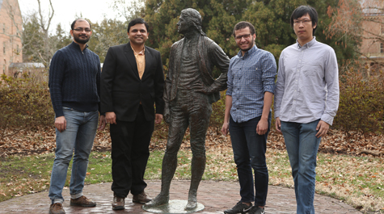

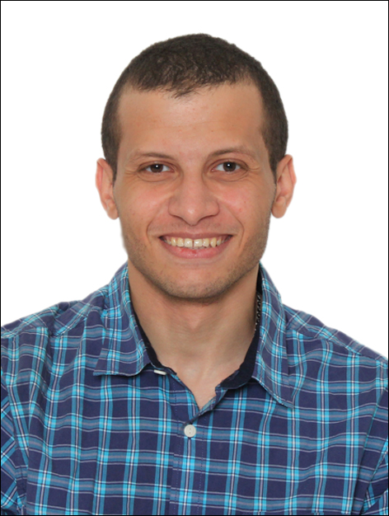


Research Group
Architecting general-purpose and domain-specific accelerators for superior
Performance/Throughput
Reliability and Security
Energy Efficiency
Fairness
More details: http://insight-archlab.github.io/

Slide 3

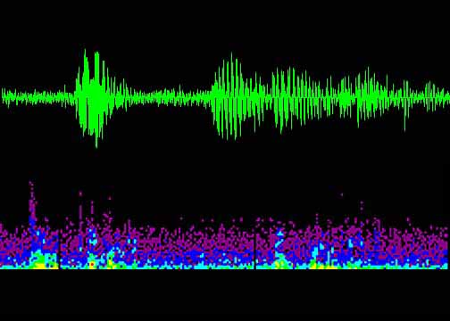

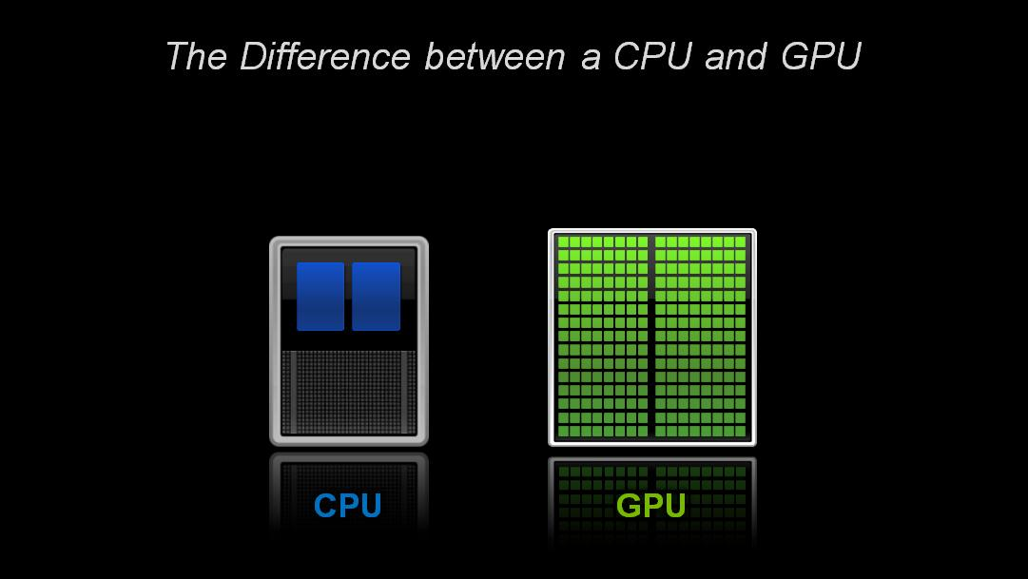

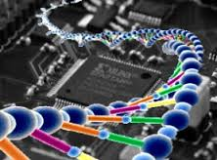



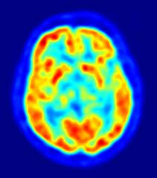

Why Accelerators?
High Speed
Accelerator
Large Number of Compute Elements
Optimized for Throughput
Large
Data Sets
Parallelism
Better Energy Efficiency
Great for
Parallel Code

Slide 4
How Acceleration Works
Communication
Accelerator
Fewer Cores
Large Number of Compute Elements
Optimized for Latency
Optimized for Throughput
Great for Sequential Code
Great for
Parallel Code
Notes:
Do not use the word “offload”

Slide 5
Memory Wall and Accelerators
General purpose (e.g., GPU)
Latency: Multi-threading
Capacity: Virtualization and UVM
Bandwidth: Memory to Compute Movement of Data
Hurts throughput / energy efficiency, exposes new attack vectors
Domain-specific
Latency/Bandwidth: Non-von Neumann architectures; spatial architectures; in-memory architectures
Capacity: Limited to no support for virtualization
Hurts throughput and reduces applicability

Slide 6
Architectural Support for Efficient Large-Scale Automata Processing
Joint work with
Hongyuan Liu, Mohamed Ibrahim (College of William & Mary),
Onur Kayiran (AMD), Sreepathi Pai (University of Rochester),
Appeared at MICRO 2018
Notes:
Hi, my name is Hongyuan Liu. Today, I will present our work “Architectural Support for Efficient Large-Scale Automata Processing”.
This work was jointly performed with my advisor and colleagues
at The College of William and Mary
and
our collaborators at AMD and University of Rochester.

Slide 7


Finite State Machine (Automata) Processing
Widely used in several areas
Existing general-purpose architectures (CPUs and GPUs) are not efficient at FSM processing
Irregular memory accesses
Limited Parallelism
Notes:
Finite state machines are widely used in different areas such as Bioinformatics, machine learning, networking intrusion detection, and XML parsing.
However, traditional von Neumann architectures are not efficient at FSM processing because of irregular memory accesses, and limited parallelism.

Slide 8
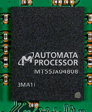
Automata Processor (AP)
In-memory Processing
Parallelism
FSMs
States
Figure from Micron website
Notes:
Automata Processor AP is a DRAM based domain specific architecture for accelerating finite state machine processing.
The automata processor performs orders of magnitude better than CPUs.
Generally, there are two reasons.
First, it exploit in-memory processing. This does not require expensive data movement.
Second, it has high amount of parallelism --- Multiple FSMs can run simultaneously, and multiple states can be activated simultaneously.

Slide 9
Background on FSM processing and its execution on AP

Slide 10
Input Stream
APPLEC
FSM
APPLE
APPLICATION
A
Match-set
Reporting state
Starting state
Enabled State
State
Activated State
S0
S1
S2
S3
S4
A
P
P
L
E
I
C
A
T
I
O
N
Starting State
(Always-enabled)
S5
S6
S7
S8
S9
S10
S11
Notes:
First, we show some backgrounds on the FSM processing.
Here is an FSM. It can identify two patterns, which are APPLE, and APPLICATION.
An FSM-based application contains multiple FSMs.
The matching process starts from the starting state, which is always enabled during the execution in our context.
The FSM-based application also requires an input stream. Here we show it as “APPLEC”.
We will show the example matching process in the following a few slides.

Slide 11
A
Match-set
Reporting state
Starting state
Enabled State
State
Activated State
APPLEC
S0
S1
S2
S3
S4
A
P
P
L
E
I
C
A
T
I
O
N
Active
S5
S6
S7
S8
S9
S10
S11
Notes:
Here we show the matching process.
In this example,
the first symbol is A. This activates the starting state S0.

Slide 12
A
Match-set
Reporting state
Starting state
Enabled State
State
Activated State
APPLEC
S0
S1
S2
S3
S4
A
P
P
L
E
Enabled
I
C
A
T
I
O
N
S5
S6
S7
S8
S9
S10
S11
Notes:
When S0 is activated, it enables its successor S1.

Slide 13
A
Match-set
Reporting state
Starting state
Enabled State
State
Activated State
APPLEC
S0
S1
S2
S3
S4
A
P
P
L
E
I
C
A
T
I
O
N
S5
S6
S7
S8
S9
S10
S11
Notes:
The second symbol is P. This activates S1.

Slide 14
A
Match-set
Reporting state
Starting state
Enabled State
State
Activated State
APPLEC
S0
S1
S2
S3
S4
A
P
P
L
E
I
C
A
T
I
O
N
S5
S6
S7
S8
S9
S10
S11
Notes:
The activated S1 enables its successor S2.

Slide 15
A
Match-set
Reporting state
Starting state
Enabled State
State
Activated State
APPLEC
Report generated
S0
S1
S2
S3
S4
A
P
P
L
E
I
C
A
T
I
O
N
S5
S6
S7
S8
S9
S10
S11
Notes:
This process continues. After several cycles, when E comes, reporting state S4 is activated.
A report is generated in this case.

Slide 16
A
Match-set
Reporting state
Starting state
Enabled State
State
Activated State
APPLEC
S0
S1
S2
S3
S4
A
P
P
L
E
I
C
A
T
I
O
N
S5
S6
S7
S8
S9
S10
S11
Notes:
The matching process continues until all symbols in the input stream are consumed.

Slide 17
FSM Processing on AP

Slide 18
S0
S1
S2
S3
S4
Input Stream: APPLEC
A
P
P
L
E
S5
S6
S7
S8
S9
S10
S11
I
C
A
T
I
O
N
S0 | S1 | S2 | S3 | S4 | S5 | S6 | S7 | S8 | S9 | S10 | S11
1 |  |  |  |  |  |  | 1
 |  |  |  |  |  | 1
 |  |  |  | 1
 |  |  |  |  | 1
 |  |  | 1
 |  |  |  |  | 1
 | 1 | 1
‘A’
‘B’
‘C’
‘D’
Input Symbol
‘E’
8x256 Decoder
…
‘L’
…
‘P’
State Bit
Routing Matrix

Slide 19
S0
S1
S2
S3
S4
Input Stream: APPLEC
A
P
P
L
E
S5
S6
S7
S8
S9
S10
S11
I
C
A
T
I
O
N
S0 | S1 | S2 | S3 | S4 | S5 | S6 | S7 | S8 | S9 | S10 | S11
1 |  |  |  |  |  |  | 1
 |  |  |  |  |  | 1
 |  |  |  | 1
 |  |  |  |  | 1
 |  |  | 1
 | 1 | 1
1
‘A’
‘B’
‘C’
‘D’
Input Symbol
‘E’
8x256 Decoder
…
‘L’
…
‘P’
State Bit
Routing Matrix

Slide 20
S0
S1
S2
S3
S4
Input Stream: APPLEC
A
P
P
L
E
S5
S6
S7
S8
S9
S10
S11
I
C
A
T
I
O
N
S0 | S1 | S2 | S3 | S4 | S5 | S6 | S7 | S8 | S9 | S10 | S11
1 |  |  |  |  |  |  | 1
 |  |  |  |  |  | 1
 |  |  |  | 1
 |  |  |  |  | 1
 |  |  | 1
 | 1 | 1
1
‘A’
‘B’
‘C’
‘D’
Input Symbol
‘E’
8x256 Decoder
‘A’
…
‘L’
…
‘P’
State Bit
Routing Matrix

Slide 21
S0
S1
S2
S3
S4
Input Stream: APPLEC
A
P
P
L
E
S5
S6
S7
S8
S9
S10
S11
I
C
A
T
I
O
N
S0 | S1 | S2 | S3 | S4 | S5 | S6 | S7 | S8 | S9 | S10 | S11
1 |  |  |  |  |  |  | 1
 |  |  |  |  |  | 1
 |  |  |  | 1
 |  |  |  |  | 1
 |  |  | 1
 | 1 | 1
1
‘A’
‘B’
‘C’
‘D’
Input Symbol
‘E’
8x256 Decoder
‘A’
…
‘L’
…
‘P’
State Bit
Routing Matrix

Slide 22
S0
S1
S2
S3
S4
Input Stream: APPLEC
A
P
P
L
E
S5
S6
S7
S8
S9
S10
S11
I
C
A
T
I
O
N
S0 | S1 | S2 | S3 | S4 | S5 | S6 | S7 | S8 | S9 | S10 | S11
1 |  |  |  |  |  |  | 1
 |  |  |  |  |  | 1
 |  |  |  | 1
 |  |  |  |  | 1
 |  |  | 1
 | 1 | 1
1 | 1
‘A’
‘B’
‘C’
‘D’
Input Symbol
‘E’
8x256 Decoder
…
‘L’
…
‘P’
State Bit
Routing Matrix

Slide 23
S0
S1
S2
S3
S4
Input Stream: APPLEC
A
P
P
L
E
S5
S6
S7
S8
S9
S10
S11
I
C
A
T
I
O
N
S0 | S1 | S2 | S3 | S4 | S5 | S6 | S7 | S8 | S9 | S10 | S11
1 |  |  |  |  |  |  | 1
 |  |  |  |  |  | 1
 |  |  |  | 1
 |  |  |  |  | 1
 |  |  | 1
 | 1 | 1
1 | 1
‘A’
‘B’
‘C’
‘D’
Input Symbol
‘E’
8x256 Decoder
‘P’
…
‘L’
…
‘P’
State Bit
Routing Matrix

Slide 24
S0
S1
S2
S3
S4
Input Stream: APPLEC
A
P
P
L
E
S5
S6
S7
S8
S9
S10
S11
I
C
A
T
I
O
N
S0 | S1 | S2 | S3 | S4 | S5 | S6 | S7 | S8 | S9 | S10 | S11
1 |  |  |  |  |  |  | 1
 |  |  |  |  |  | 1
 |  |  |  | 1
 |  |  |  |  | 1
 |  |  | 1
 | 1 | 1
1 |  | 1
‘A’
‘B’
‘C’
‘D’
Input Symbol
‘E’
8x256 Decoder
…
‘L’
…
‘P’
State Bit
Routing Matrix

Slide 25
S0
S1
S2
S3
S4
Input Stream: APPLEC
A
P
P
L
E
S5
S6
S7
S8
S9
S10
S11
I
C
A
T
I
O
N
S0 | S1 | S2 | S3 | S4 | S5 | S6 | S7 | S8 | S9 | S10 | S11
1 |  |  |  |  |  |  | 1
 |  |  |  |  |  | 1
 |  |  |  | 1
 |  |  |  |  | 1
 |  |  | 1
 | 1 | 1
1 |  | 1
‘A’
‘B’
‘C’
‘D’
Input Symbol
‘E’
8x256 Decoder
‘P’
…
‘L’
…
‘P’
State Bit
Routing Matrix

Slide 26
S0
S1
S2
S3
S4
Input Stream: APPLEC
A
P
P
L
E
S5
S6
S7
S8
S9
S10
S11
I
C
A
T
I
O
N
S0 | S1 | S2 | S3 | S4 | S5 | S6 | S7 | S8 | S9 | S10 | S11
1 |  |  |  |  |  |  | 1
 |  |  |  |  |  | 1
 |  |  |  | 1
 |  |  |  |  | 1
 |  |  | 1
 | 1 | 1
1 |  |  | 1
‘A’
‘B’
‘C’
‘D’
Input Symbol
‘E’
8x256 Decoder
…
‘L’
…
‘P’
State Bit
Routing Matrix

Slide 27
S0
S1
S2
S3
S4
Input Stream: APPLEC
A
P
P
L
E
S5
S6
S7
S8
S9
S10
S11
I
C
A
T
I
O
N
S0 | S1 | S2 | S3 | S4 | S5 | S6 | S7 | S8 | S9 | S10 | S11
1 |  |  |  |  |  |  | 1
 |  |  |  |  |  | 1
 |  |  |  | 1
 |  |  |  |  | 1
 |  |  | 1
 | 1 | 1
1 |  |  | 1
‘A’
‘B’
‘C’
‘D’
Input Symbol
‘E’
8x256 Decoder
‘L’
…
‘L’
…
‘P’
State Bit
Routing Matrix

Slide 28
S0
S1
S2
S3
S4
Input Stream: APPLEC
A
P
P
L
E
S5
S6
S7
S8
S9
S10
S11
I
C
A
T
I
O
N
S0 | S1 | S2 | S3 | S4 | S5 | S6 | S7 | S8 | S9 | S10 | S11
1 |  |  |  |  |  |  | 1
 |  |  |  |  |  | 1
 |  |  |  | 1
 |  |  |  |  | 1
 |  |  | 1
 | 1 | 1
1 |  |  |  | 1 | 1
‘A’
‘B’
‘C’
‘D’
Input Symbol
‘E’
8x256 Decoder
…
‘L’
…
‘P’
State Bit
Routing Matrix

Slide 29
S0
S1
S2
S3
S4
Input Stream: APPLEC
A
P
P
L
E
S5
S6
S7
S8
S9
S10
S11
I
C
A
T
I
O
N
S0 | S1 | S2 | S3 | S4 | S5 | S6 | S7 | S8 | S9 | S10 | S11
1 |  |  |  |  |  |  | 1
 |  |  |  |  |  | 1
 |  |  |  | 1
 |  |  |  |  | 1
 |  |  | 1
 | 1 | 1
1 |  |  |  | 1 | 1
‘A’
‘B’
‘C’
‘D’
Input Symbol
‘E’
8x256 Decoder
‘E’
…
‘L’
…
‘P’
State Bit
Routing Matrix

Slide 30
S0
S1
S2
S3
S4
Input Stream: APPLEC
A
P
P
L
E
S5
S6
S7
S8
S9
S10
S11
I
C
A
T
I
O
N
S0 | S1 | S2 | S3 | S4 | S5 | S6 | S7 | S8 | S9 | S10 | S11
1 |  |  |  |  |  |  | 1
 |  |  |  |  |  | 1
 |  |  |  | 1
 |  |  |  |  | 1
 |  |  | 1
 | 1 | 1
1
‘A’
‘B’
‘C’
‘D’
Input Symbol
‘E’
8x256 Decoder
…
‘L’
…
‘P’
State Bit
Routing Matrix

Slide 31
S0
S1
S2
S3
S4
Input Stream: APPLEC
A
P
P
L
E
S5
S6
S7
S8
S9
S10
S11
I
C
A
T
I
O
N
S0 | S1 | S2 | S3 | S4 | S5 | S6 | S7 | S8 | S9 | S10 | S11
1 |  |  |  |  |  |  | 1
 |  |  |  |  |  | 1
 |  |  |  | 1
 |  |  |  |  | 1
 |  |  | 1
 | 1 | 1
1
‘A’
‘B’
‘C’
‘D’
Input Symbol
‘E’
8x256 Decoder
‘C’
…
‘L’
…
‘P’
State Bit
Routing Matrix

Slide 32
Problem

Slide 33
Applications are getting larger
ClamAV: Anti-virus database that identifies virus characteristics via FSMs
Snort: Network intrusion detection identifies many intrusion patterns via FSMs
Many more…
Notes:
However, there is sill a problem when we use AP to do the FSM processing.
For example, currently,
there are many emerging applications that consist of many FSM states.
For example, ClamAV is an anti-virus application. Each characterization of virus is stored as an FSM. Therefore, the database of virus is increasing over time.
Another example is Snort, where it uses FSM to represent each intrusion pattern.
We expect such applications will become more common in the future.

Slide 34

Applications are getting larger
AP Capacity is Limited
How do we accelerate large-scale FSM processing?
Notes:
As a result, there is a challenge to use AP efficiently.
On one side, the applications are getting larger.
On the other side, the AP capacity is limited.
In this research, we focus on how to accelerate large-scale FSM processing using automata processor.

Slide 35
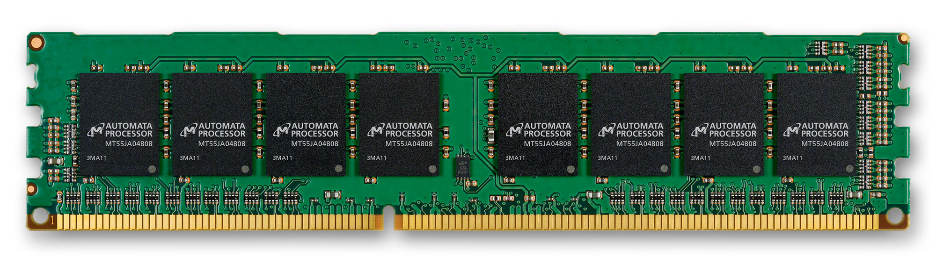
Current situation: Repeated Executions
Input Stream:
ORANGEAPPLEBANANAPEARPEACH….
Configure Batch 1
1st Execution
Application
Notes:
An application consists of many FSMs.
If the number of FSM states cannot fit in AP at one time, multiple batches are needed.
For example, we configure the first batch to the AP, and run the input stream on it.

Slide 36
Current situation: Repeated Executions
Input Stream:
ORANGEAPPLEBANANAPEARPEACH….
2nd Execution
Configure Batch 2
Application
Notes:
Then, we configure the second batch to the AP, and run the same input stream on it AGAIN.
This execution repeats until all batches are configured and executed on AP.
This repeated executions lead to inefficiencies.

Slide 37
Observation and Motivation

Slide 38
After the execution
Some states are never enabled (cold)!
S0
S1
S2
S3
S4
A
P
P
L
E
Cold States
Hot States
S6
S7
S8
S9
S10
S11
I
C
A
T
I
O
N
S5
Notes:
To revisit the example we show before, we found there might be a number of states are configured to AP, but are never used.
We call them cold states in our work, while the enabled states are hot states in our work.
We found that, in the previous example, S6 to S11 are cold.

Slide 39
Underutilization of AP
Because of mismatch, there are many cold states configured to AP.
Notes:
Going forward, we evaluate all these real applications.
In this figure, the y-axis is the percentage of states.
We found that a large portion of states are cold. On average, there are 59% of cold states.
The reason of cold states is mismatch, where there are not enough interesting patterns occur in the input stream.

Slide 40
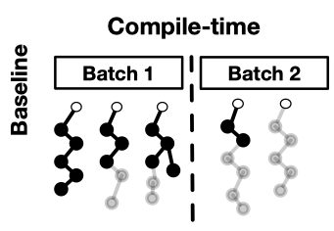
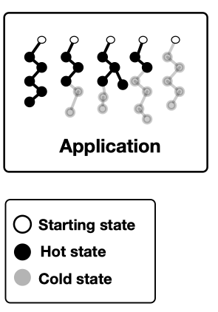
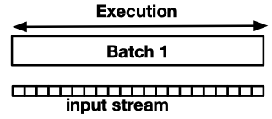
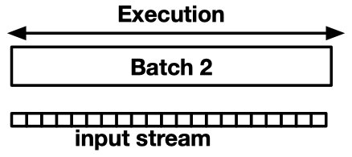
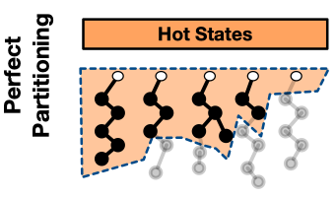
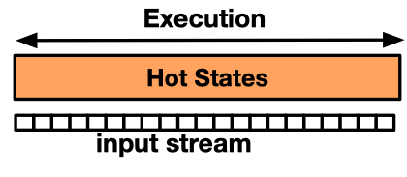
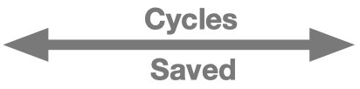
Benefits of only configuring hot states
Time
Notes:
So, ideally, if we can only configure the hot states, we can get performance benefits.
Here is an example illustrating the performance benefits of configuring only hot states.
In the baseline case,
the application is split to two batches.
At runtime, the AP needs to execute the same input stream for each batch.
On the contrary,
now suppose we have an oracular knowledge of cold states,
and in this case, the hot states could fit in one batch.
In comparison, at runtime, the AP only executes the input stream once, which leads to significant cycle savings.

Slide 41
Outline
Introduction
Background and Motivation
Challenges and Our Approach
Results
Conclusions
Notes:
Next, to realize the benefits as much as possible, we will discuss the challenges and our approach.

Slide 42
Challenges
How do we predict and partition?
How do we handle the mispredictions?
Notes:
However, to realize the benefits, we have two challenges.
First, how do we predict a state is cold or hot at compile time?
Second, how do we partition the FSMs in the application, and only configure the hot states?

Slide 43
Which states are more likely to be hot?
A
P
P
L
E
I
C
A
T
I
O
N
Shallow states ➔ Hot.
Deep states ➔ Cold (Details in the paper)
Notes:
First, we study which states are more likely to be hot.
Consider the previous example, we found the shallow states are hot.
This is because, the matching process is always from lower topological order to higher topological order.
---- We define a state is shallow or deep based on its topological order.
We study the hot states in these applications. We found that the shallow states are more likely to be hot.
Similarly, deep states are more likely to be cold.

Slide 44
How do we partition?
AP
We use a simple but effective offline profiling mechanism to determine the partition topological-order. (More details in the paper)
Partition via topological order makes transition unidirectional.
A
P
P
L
E
Topological Order
K = 5
I
C
A
T
I
O
N
Notes:
Based on this observation, we propose to use topological order to partition the FSMs.
Consider the previous example, we can partition it at topological order K = 5.
We only configure the states with topological orders no greater than 5 to the AP.
-----------------------------------------------
To determine the partitioning topological order for each FSM in the application, we use a simple offline profiling mechanism.
Second, partition via topological order makes transition unidirectional. Therefore, no back and forth transition will happen, which simplifies the misprediction handling. We will show it later.

Slide 45
How do we handle the mispredictions?
AP
APPLICATION
A
P
S2
S2
P
S3
K = 3
S3’
L
S4
S5
Intermediate
reporting state
A
P
P
L
E
I
C
A
T
I
O
N
Generated intermediate report
AP
A
P
S3; cycle 3
S2
P
S3’
L
Notes:
However, it is hard to predict the topological order correctly.
Now, suppose we have an imperfect partition at topological order k = 3.
In this partition,
--- S3, S4, S5 were partitioned out of AP, but they are actually hot. ----
In this case, a transition may go outside of the AP.
To notify the handler about the mispredictions, we add an intermediate reporting state for each cutting edge across the partition topological order.
In this case, the cutting edge is S2 to S3.
Then we attach S3’ to S2.
Therefore, in addition to the predicted hot states, the intermediate reporting states are also configured to AP.
-----------------------------------------------------
Consider current input steam is APPLICATION instead. The current symbol is L.
It makes the intermediate reporting state S3’ activated. So, an intermediate report is generated.
The report consists of two parts.
First, the state that to be continued in the misprediction handling.
Second, the cycle number where the report was generated.
In the following slides, we will show how to handle the list of generated intermediate reports.

Slide 46
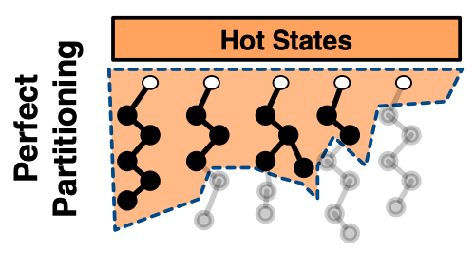
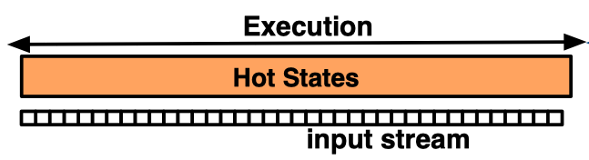
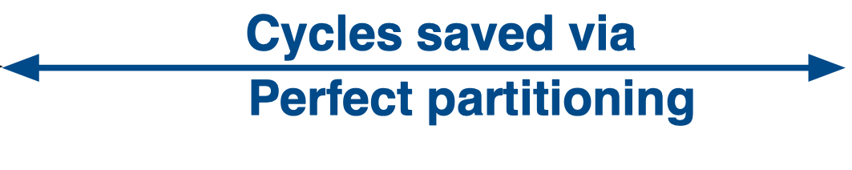
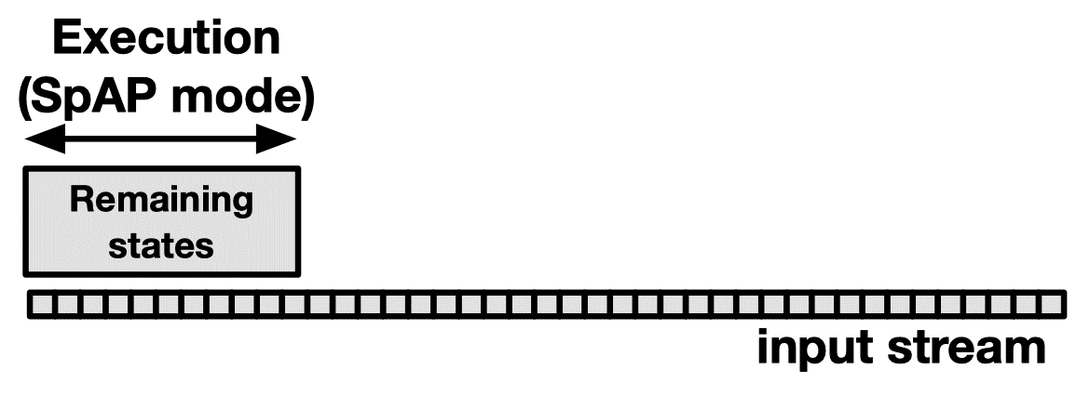
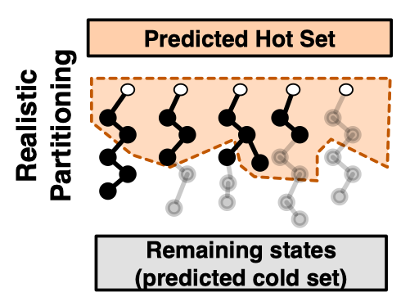
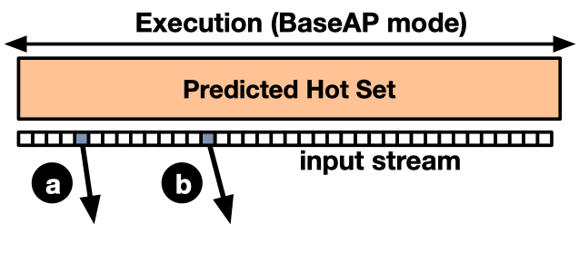
Handle the mispredictions --- SparseAP
Time
Cycle 5
Cycle 14
Notes:
To handle the intermediate reports caused by mispredictions, we propose SparseAP, which is an execution mode of AP.
It has two operations.
First, the enable operation enables the state to be continued in the matching process.
Second, the jump operation that jumps to a certain input position.
====
Here, we consider the realistic partition case. We partition the FSM states to predicted hot set, and predicted cold set.
We configure the predicted hot set to the BaseAP. During the BaseAP execution, transitions coming out the scope of predicted hot set are recorded in a list of intermediate reports.
In this example, the AP execution generates two intermediate reports, which are shown in (a) and (b).
After the AP execution, we handle the generated intermediate reports using SparseAP mode. We configure the predicted cold states to the SparseAP mode.

Slide 47
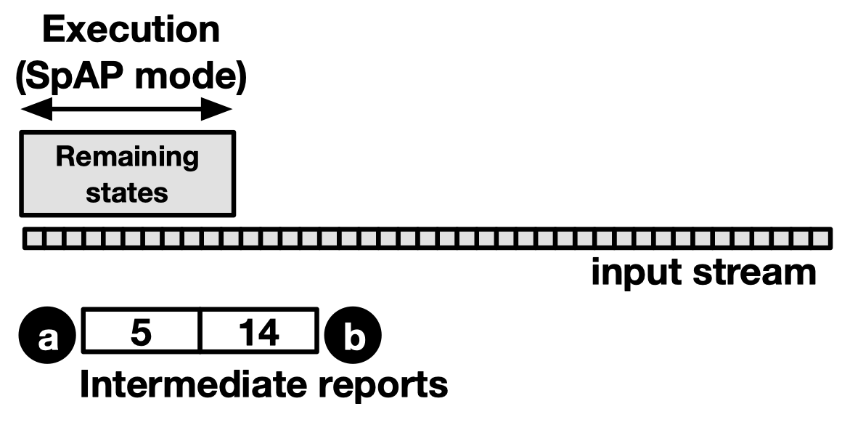
Handle the mispredictions --- SparseAP
Time
Notes:
Suppose the intermediate reports were generated at cycle 5 and cycle 14.

Slide 48
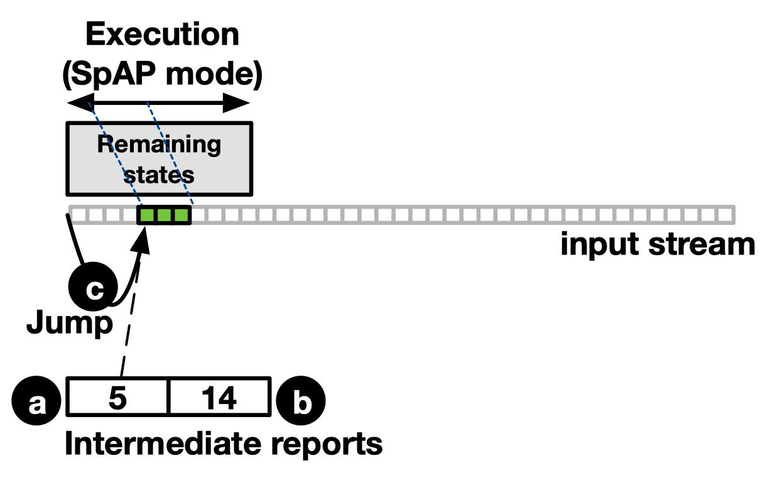
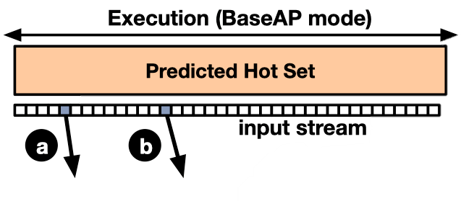
Handle the mispredictions --- SparseAP
Time
Notes:
At SparseAP mode, since there is no enabled state initially, we perform a jump operation to cycle 5 directly.
We enable the state that is to be continued.
After several cycles, there is no state enabled in SparseAP. This is either because of mismatch, or because a report is generated.

Slide 49
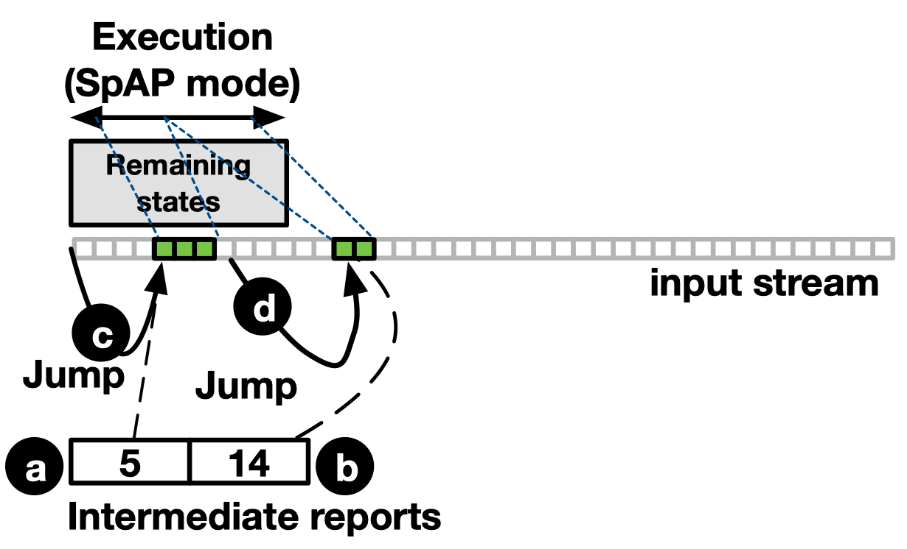
Handle the mispredictions --- SparseAP
Time
Notes:
Then the SparseAP performs a jump operation again. This jumps to the cycle where the second intermediate report was generated, which is 14.

Slide 50
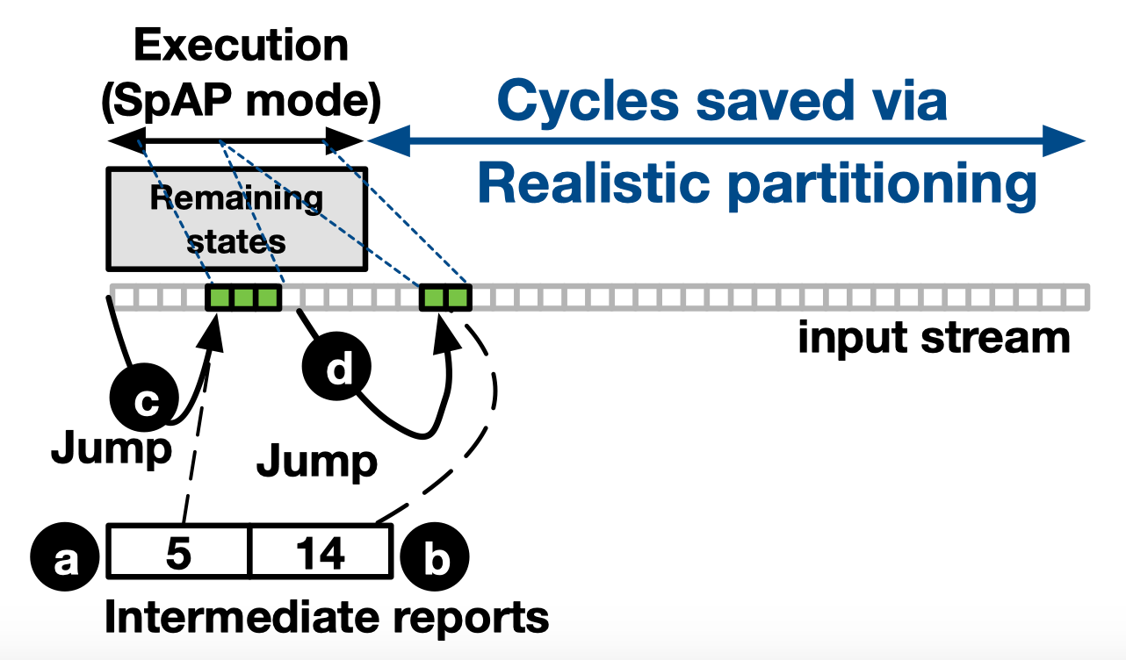
Handle the mispredictions --- SparseAP
Time
Notes:
After several cycles, there is no enabled state, and there is no intermediate reports to be handled. This finishes the SparseAP execution.

Slide 51
Evaluation Methodology
Our baseline AP
AP half-core
We build our evaluations on VASim
Benchmarks
ANMLZoo
RegEx
Offline profiling and testing input
0.1% and 1% of input as representative profiling input.
The rest is the testing input.
Notes:
We use an AP half-core as our baseline architecture.
We build our evaluations on VASim, which is a cycle-accurate simulator for automata processing.
We use two entire benchmark suites, ANMLZoo and Regex.
We use 0.1% and 1% of 1MB input as our representative input in the compiling time. We use the rest of input as our testing input.

Slide 52
Speedup
47x
2.1
1.8
Speedup is related to the underutilization of each application
Limited improvement when NFAs have SCC or when applications are small
Notes:
Over the evaluated applications, our approach achieves up to 47x speedup.
Our approach achieves 1.8x and 2.1x speedup respectively on average using 0.1% and 1% profiling input.
The speedup is also related to the underutilization of each application.

Slide 53
Performance per area
32.1%
32% improvement in performance per area
More results are in the paper
Resource savings
Sensitivity to AP capacity
Effectiveness of SparseAP
…
Notes:
To measure the utilization efficiency of AP, we use a metric --- performance per area.
From this result, our approach achieves 32.1% improvement in terms of performance per STE.
More results are in the paper.

Slide 54
Conclusions
We show that many FSM states are cold (never-enabled) on AP leading to its underutilization.
We propose a novel topological-order based partitioning mechanism for FSMs that partitions only predicted hot states on AP.
We handle the mispredictions using a new execution mode (SparseAP) of AP.
Our low-overhead hardware/software approach achieves 2.1× geometric mean speedup (up to 47×) across 26 applications.

Slide 55
Memory Wall and Accelerators
General purpose (e.g., GPU)
Latency: Multi-threading
Capacity: Virtualization, UVM, Multi-app Support
Bandwidth: Memory to Compute Movement of Data
Hurts throughput / energy efficiency, exposes new attack vectors
Domain-specific
Latency/Bandwidth: Non-von Neumann architectures; spatial architectures, in-memory architectures
Capacity: Limited to no support for virtualization
Hurts throughput and reduces applicability

Slide 56
Memory Bandwidth Wall
Sub-optimal throughput
55%
GPGPU Applications
Percentage of total execution cycles wasted waiting for the data

Slide 57
Memory Coalescing
Reduces Redundant Thread Requests in a deterministic manner
Popular way to reduce memory traffic
However it can expose an attack vector
Can we thwart in a low-overhead manner?

Slide 58
RCoal: Mitigating GPU Timing Attack via Subwarp-based Randomized Coalescing Techniques
Joint Work with
Gurunath Kadam (College of William and Mary)
Danfeng Zhang (Penn State University)
Appeared at HPCA 2018
Notes:
Hi, my name is Hongyuan Liu. Today, I will present our work “Architectural Support for Efficient Large-Scale Automata Processing”.
This work was jointly performed with my advisor and colleagues
at The College of William and Mary
and
our collaborators at AMD and University of Rochester.

Slide 59
Memory Access Coalescing in GPUs
Streaming Multiprocessor
Warp pool
Warp
Thread # 1
. . .
Thread # 32
Warp Scheduler
LD/ST Unit
Coalescing Unit
Global Memory

Slide 60
Memory Access Coalescing in GPUs
WARP
tid = thread id
tid = 0
tid = 1
tid = 2
tid = 3
0x00
0x04
0x07
0x09
Block Address # 0
0x00
0x01
0x02
0x03
Block Address # 1
0x04
0x05
0x06
0x07
Block Address # 1
0x04
0x05
0x06
0x07
Block Address # 2
0x08
0x09
0x0A
0x0B

Slide 61
Memory Access Coalescing in GPUs
WARP
tid = thread id
tid = 0
tid = 1
tid = 2
tid = 3
0x00
0x04
0x07
0x09
Coalescing Unit
Block Address # 0
0x00
0x01
0x02
0x03
Block Address # 1
0x04
0x05
0x06
0x07
Block Address # 2
0x08
0x09
0x0A
0x0B

Slide 62
Security Concerns
GPUs may be accelerating cryptographic applications (e.g., AES, RSA etc.) and authentication algorithms on-behalf of CPUs (Graviton, OSDI’18)
GPUs may be accelerating applications that are using user-sensitive data (e.g., genomics, financial)
It is imperative to keep GPUs secure against a variety of side-channel attacks and other security vulnerabilities.

Slide 63
Security Attacks
User’s web activity on GPU can be tracked by the malicious attacker who is co-located on the same card [Oakland 2014]
AES private keys can be recovered by correlation timing attacks [HPCA 2016]
More severe attacks on GPUs? [Oakland’18]
Spectre/Meltdown like attacks for GPUs?

Slide 64








Correlation Timing Attacks
Server
Plaintexts | Ciphertexts | Time duration
Plaintext # 1
Ciphertext # 1
time₁
Plaintext # 2
Ciphertext # 2
time₂
Plaintext # 3
Ciphertext # 3
time₃
…
…
…
Correct Key??
Correct Key
K₁ , K₂ , … ,
, …
K_{i}
Attacker
time_{start}
- time_{stop} = time₁
Key guesses
Notes:
This should be a general timing attack description

Slide 65
Correlation Timing Attack
Execution time < -- > coalesced accesses
GPU memory leakage
Private keys / cipher text < -- > coalesced accesses
GPU compute leakage

Slide 66
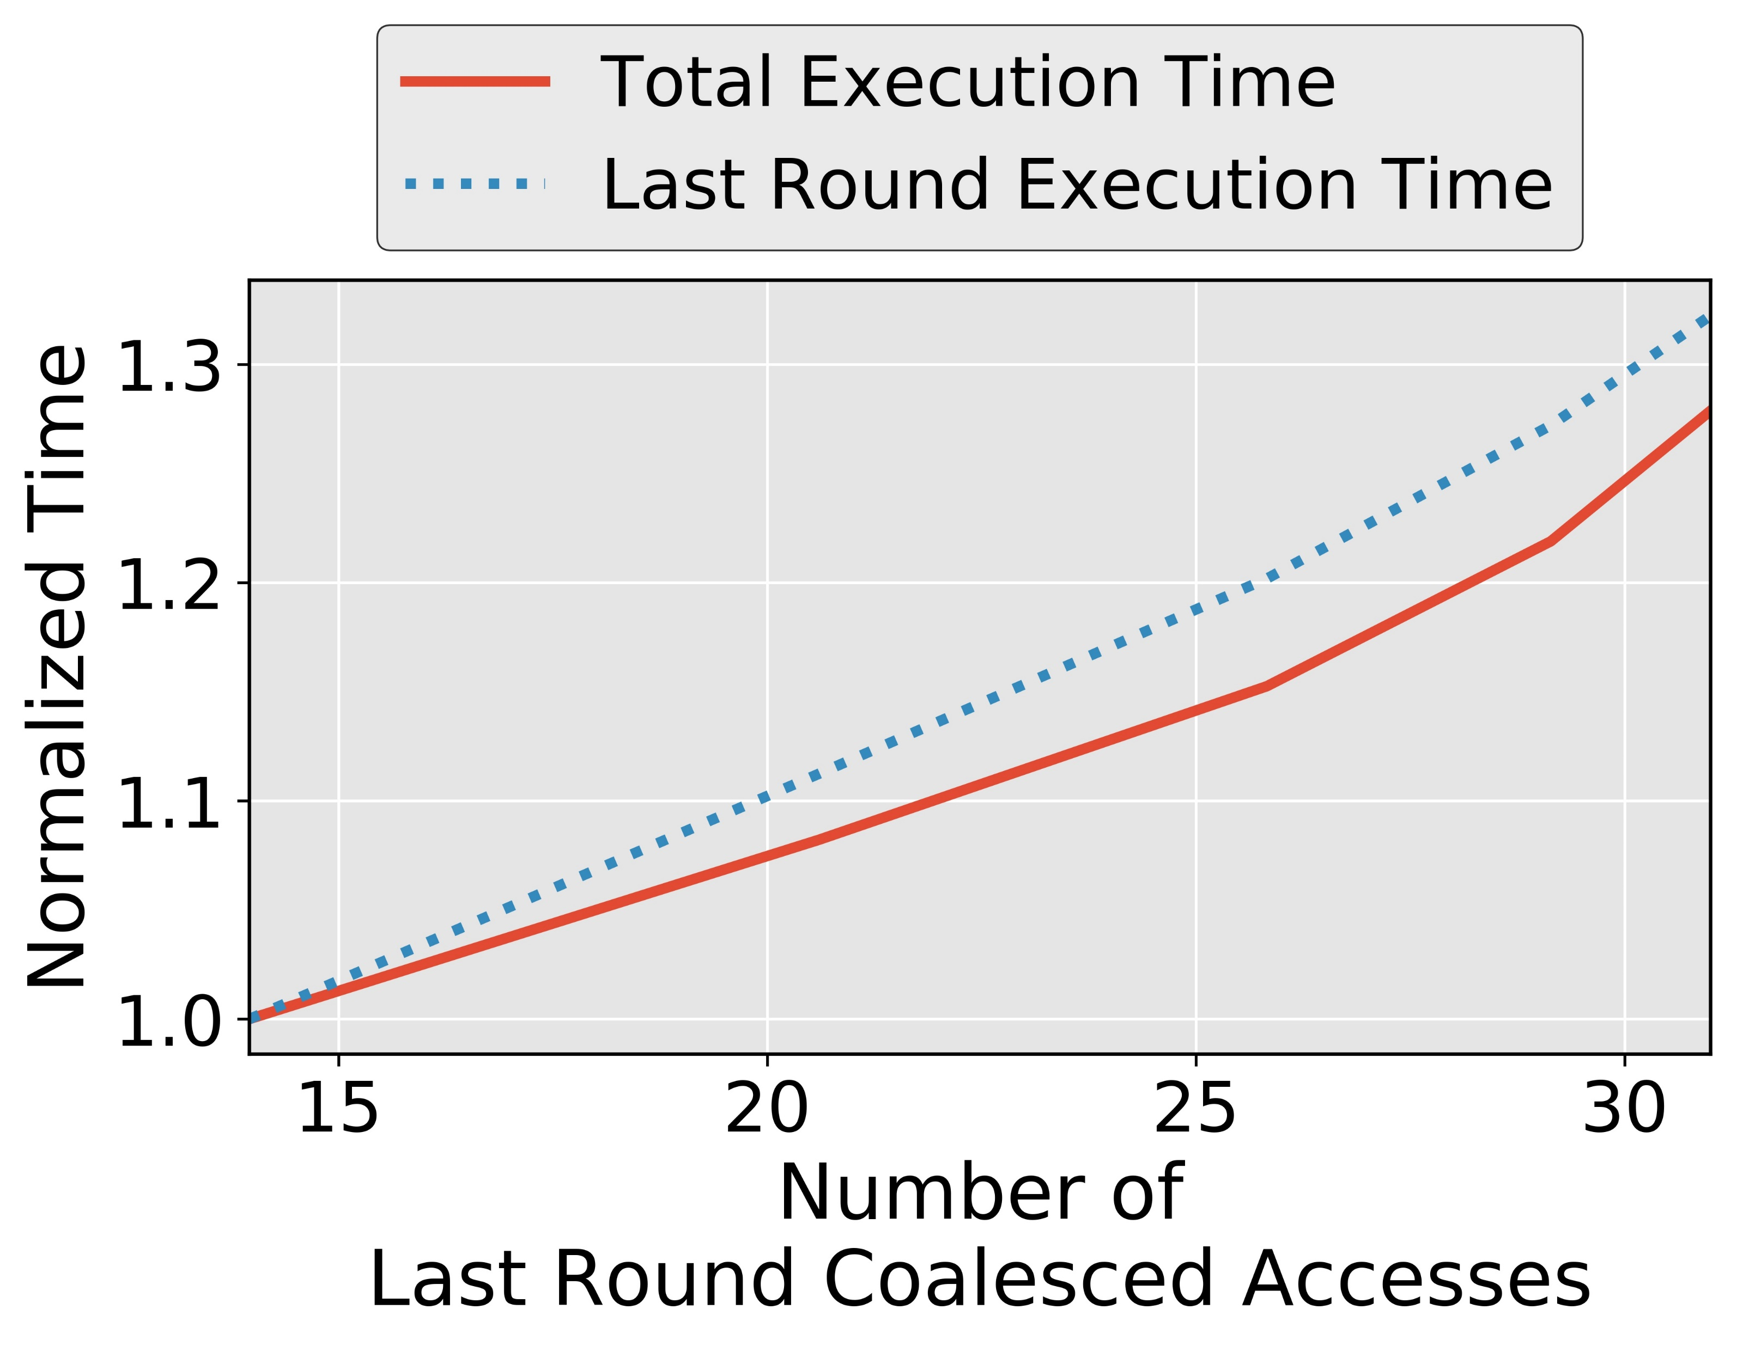
Coalesced Accesses and Execution Time
Associate the number of coalesced accesses with execution time
Notes:
Say on our set-up

Slide 67
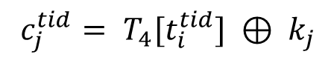
Last Round of AES on GPU
$c_{j}^{tid}= T_{4}[t_{i}^{tid}] ⊕ k_{j}$

Slide 68
Last Round of AES on GPU
$c_{j}^{tid}= T_{4}[t_{i}^{tid}] ⊕ k_{j}$
t_{i}¹
Thread # 1
T₄[t_{i}¹]
Request # 1
Replies # 1
⊕ k_{j}
c_{j}¹
LINE # 1
LINE # 2
Thread # 2
T₄[t_{i}²]
Request # 2
Replies # 2
⊕ k_{j}
t_{i}²
c_{j}²
.
.
.
.
.
.
.
.
.
.
.
.
.
.
.
.
.
.
.
.
.
.
.
.
…
…
Coalescing
Unit
…
…
t_{i}³²
Thread # 32
T₄[t_{i}³²]
Request # 32
Replies # 32
⊕ k_{j}
LINE # 32
c_{j}³²
Input text
to Last Round
Ciphertext

Slide 69
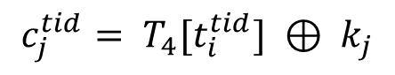
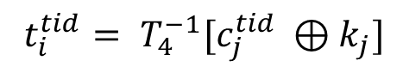
Correlation Timing Attack on GPU
Goal of the attack: Recover the AES Key (byte-by-byte)
Last Round of AES is vulnerable
Last Round is invertible
$$c_{j}^{tid}= T_{4}[t_{i}^{tid}] ⊕ k_{j}$$
Memory access
of thread tid
$t_{i}^{tid}= T_{4}^{−1}[c_{j}^{tid} ⊕k_{j}]$
How an attacker can calculate the number of coalesced accesses?
Notes:
After the goal, Attack model – using figure slide 2. What is available to the attacker – ciphertext, execution time and AES Tables.

Slide 70
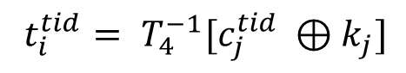
Attacker calculates the # of coalesced accesses
$t_{i}^{tid}= T_{4}^{−1}[c_{j}^{tid} ⊕k_{j}]$
Guessed Table
Lookup Indices
c_{j}¹
⊕ k_{j}^{m}
T₄⁻¹[c_{j}¹⊕k_{j}^{m}]
t_{i}^{1,m}
c_{j}²
⊕ k_{j}^{m}
T₄⁻¹[c_{j}²⊕k_{j}^{m}]
t_{i}^{2,m}
Correct value of key byte?
.
.
.
.
.
.
.
.
.
.
.
.
.
.
.
.
.
.
.
.
.
…
…
Coalesced Accesses
(A_{j}^{m,n})
c_{j}³²
⊕ k_{j}^{m}
T₄⁻¹[c_{j}³²⊕k_{j}^{m}]
t_{i}^{32,m}
Ciphertext

Slide 71
Finding the Correct Key Value
Attacker encrypts ‘N’ number of plaintexts over server
Records Ciphertext and Execution time
Recorded
Execution Time
# of Coalesced Accesses
Correlations
Key Guess 0
A_{j}^{0,1}, A_{j}^{0,2}, . . . . , A_{j}^{0,N}
E₁,E₂,...,E_{N}
Corr_{j}⁰
Key Guess 1
A_{j}^{1,1}, A_{j}^{1,2}, . . . . , A_{j}^{1,N}
Corr_{j}¹
.
.
.
.
.
.
Correct
Key Byte
Maximum Correlation
Key
Guess α
A_{j}^{α,1}, A_{j}^{α,2}, . . . . , A_{j}^{α,N}
Corr_{j}^{α}
.
.
.
.
.
.
Key
Guess 255
A_{j}^{255,1}, A_{j}^{255,2}, . . . . ,A_{j}^{255,N}
Corr_{j}²⁵⁵
Notes:
Eliminate the slide transition

Slide 72
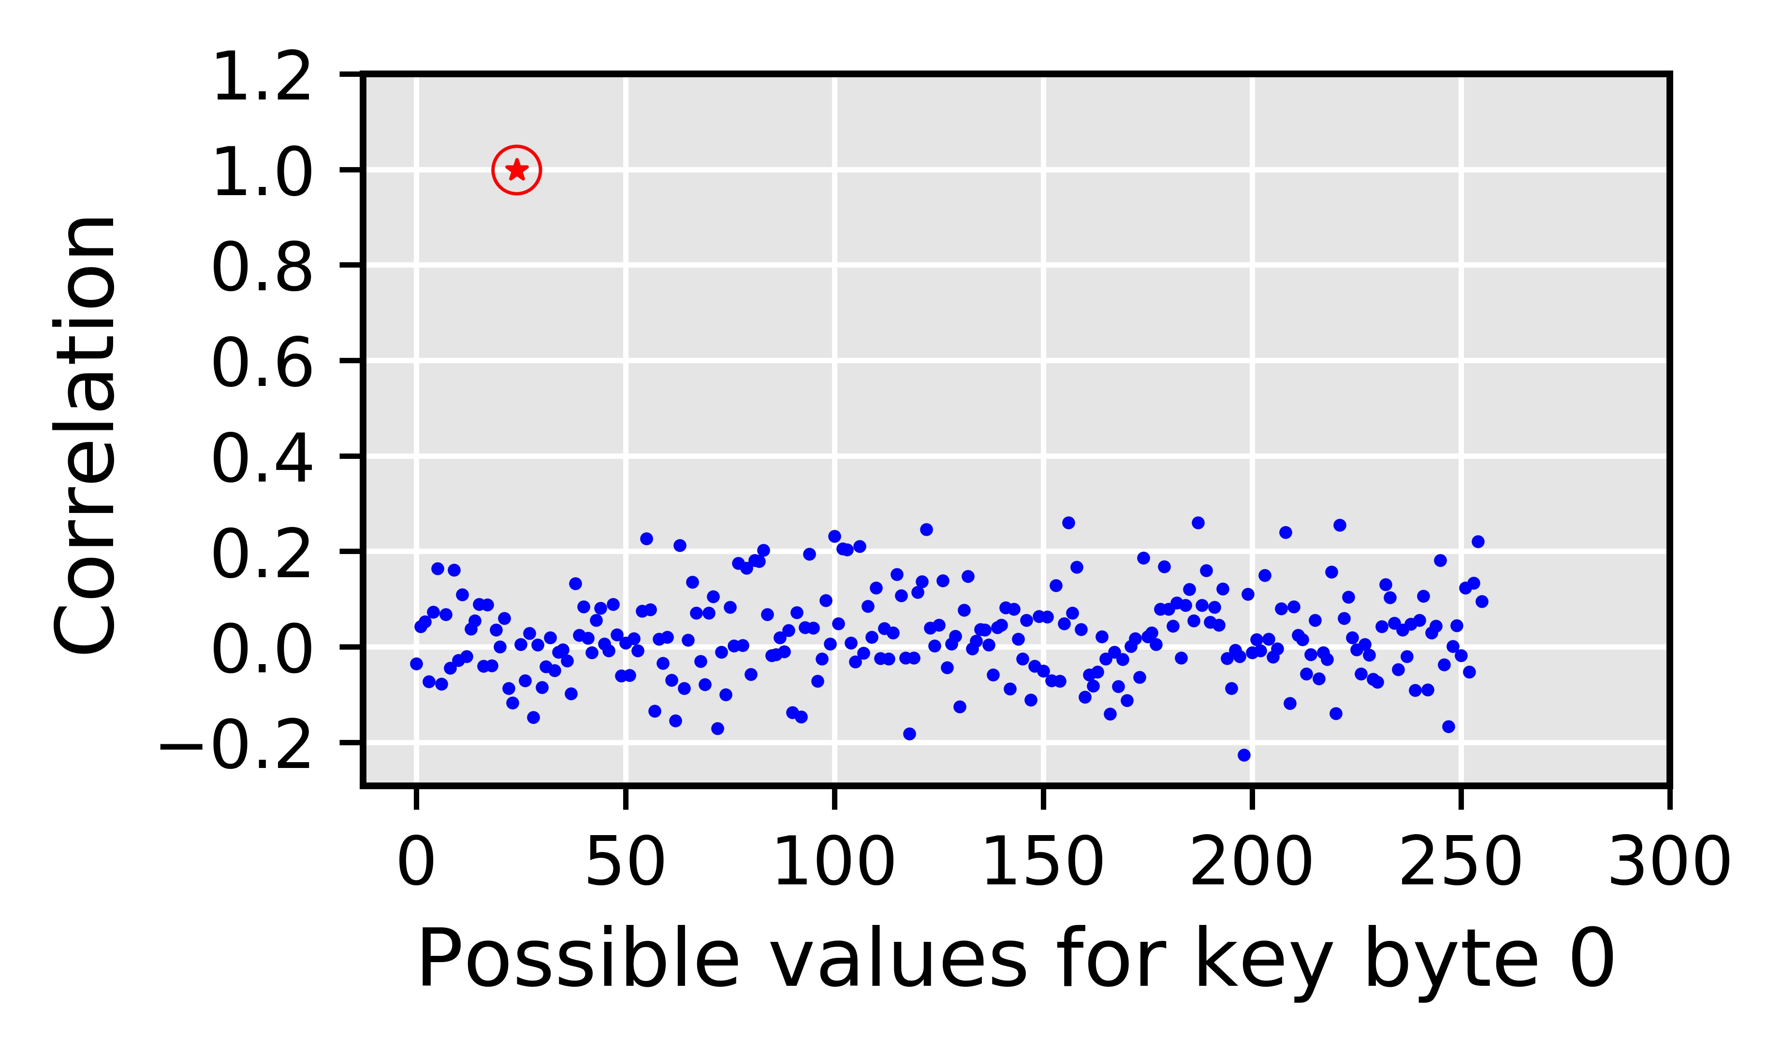
Simulating Timing Attack on our Set-up
Why is Correlation Timing Attack possible?
The baseline attack leverages the deterministic nature of the coalescing mechanism
AES key value affects the coalesced accesses
# coalesced accesses affects the execution time
How to mitigate Correlation Timing Attacks on GPU?
Answer: By making it harder for the attacker to correctly calculate the number of coalesced accesses
Correct guess
Incorrect guesses
Notes:
TODO: Coalescing good for performance and bad for security

Slide 73
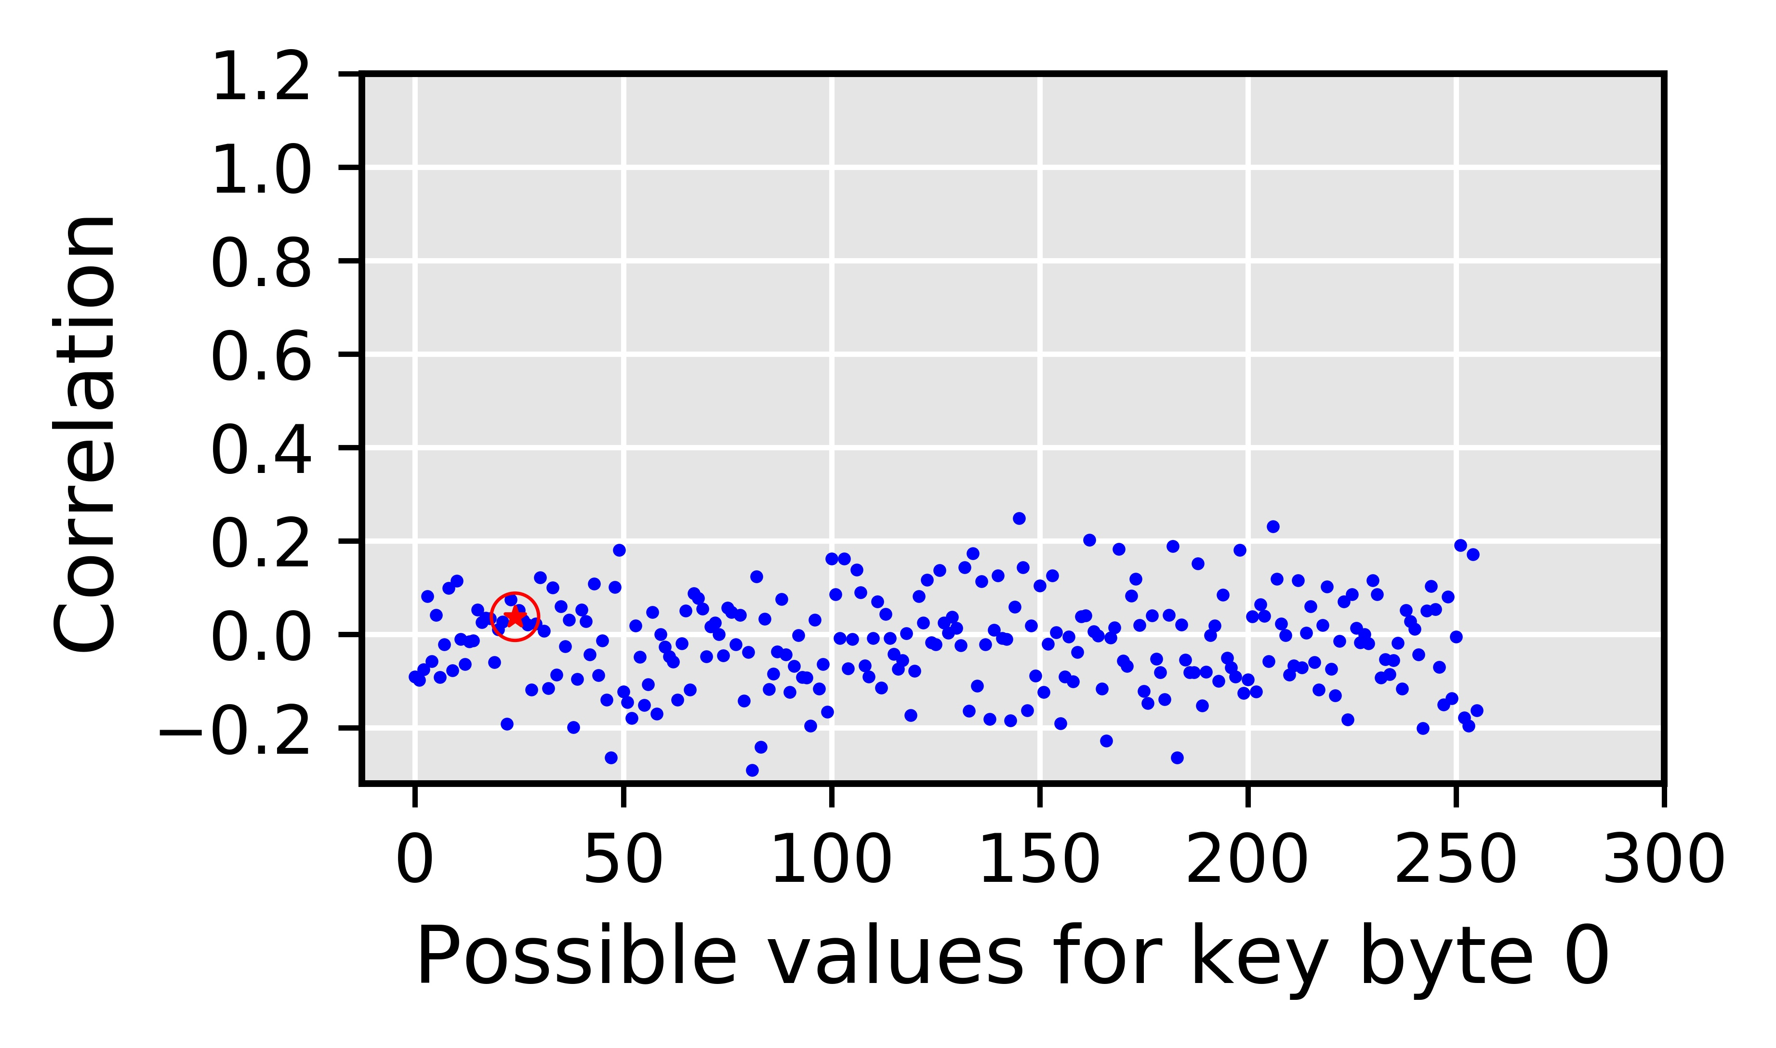
Naïve Solution
Targets the deterministic nature of the coalescing mechanism
Fixed number of subwarps
Fixed sizes of subwarp
Deterministic mapping of the thread elements to subwarps
Disable coalescing altogether?
Correlation drops to ~0
Correct key byte is indistinguishable
Up to 178% performance degradation
Degradation increases with plaintext size
RCoal to mitigate the correlation timing
attacks
Correct guess
Naïve solution is Good for Security, Bad for Performance
Offers no tradeoff

Slide 74
RCoal: Fixed Sized Subwarp (FSS)
DEFAULT: number of subwarps = 1
FSS: number of subwarps = 2
sid = 0
sid = 0
sid = 1
tid = 0
tid = 1
tid = 2
tid = 3
tid = 0
tid = 1
tid = 2
tid = 3
0x00
0x04
0x07
0x09
0x00
0x04
0x07
0x09
Coalescing Unit
Coalescing Unit
0x00
0x01
0x02
0x03
0x00
0x01
0x02
0x03
0x04
0x05
0x06
0x07
0x04
0x05
0x06
0x07
0x04
0x05
0x06
0x07
0x08
0x09
0x0A
0x0B
0x08
0x09
0x0A
0x0B
Notes:
Fixed Size Subwarp eliminates the fixed number of subwarps based determinism.

Slide 75
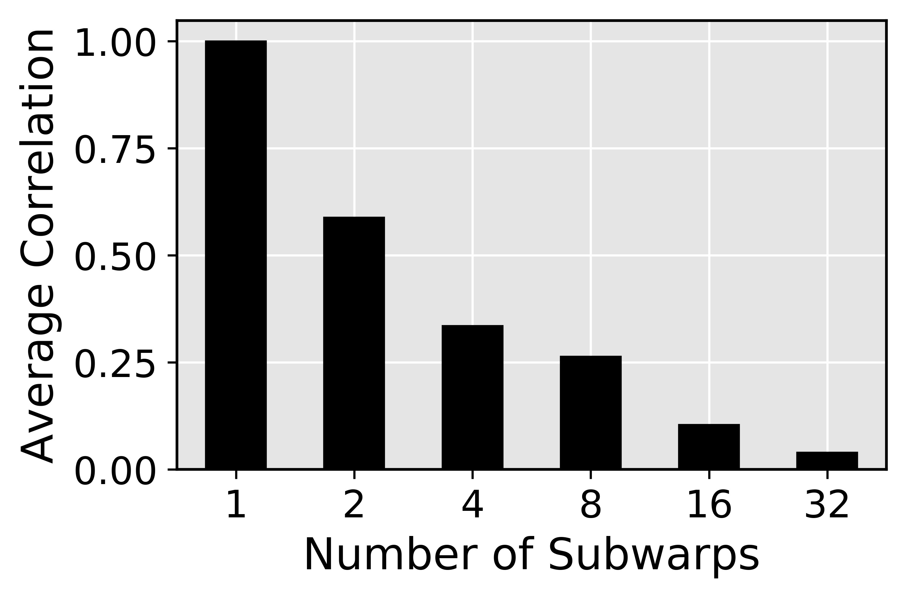
FSS Security against Baseline Attack
Correlation between the number of coalesced accesses and the execution time drops
Correct key byte is harder to find
Improved security

Slide 76
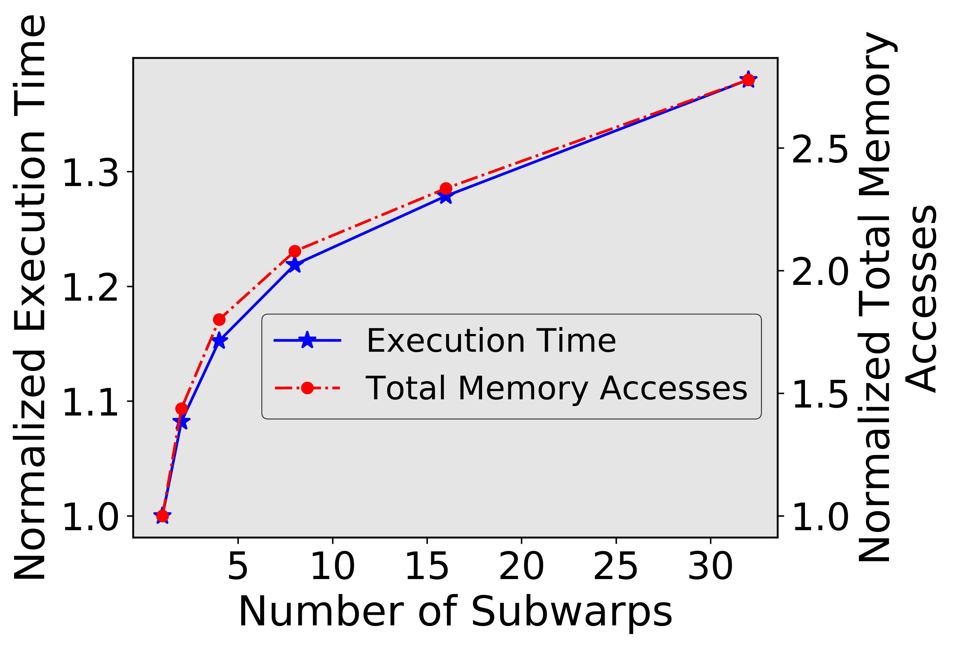
FSS Performance
Memory accesses increase with number of subwarps
Execution time increases with number of subwarps
Performance degrades as number of subwarp increase
Can attacker still recover the AES key?
Notes:
Better transition going into FSS attack

Slide 77

FSS against FSS attack
Attacker can figure out the number of subwarps
Notes:
Why FSS attack?

Slide 78
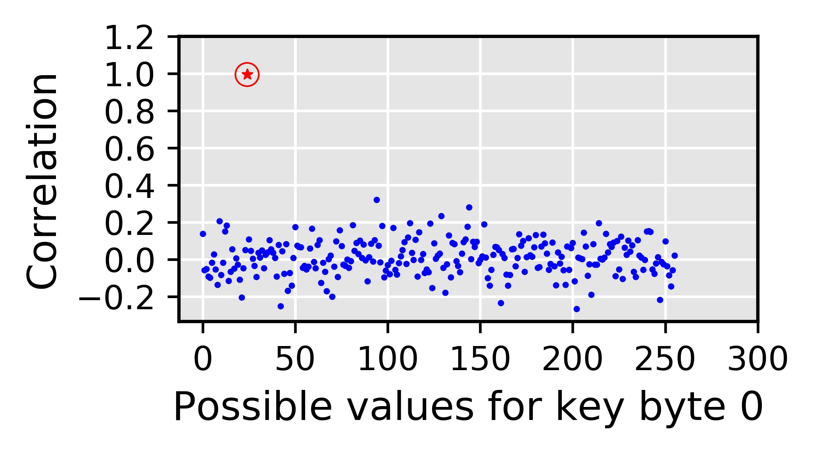
FSS against FSS attack
Attacker can figure out the number of subwarps
Attacker can calculate per subwarp accesses
Correct guess

Slide 79
FSS against FSS attack
Targets the deterministic nature of the coalescing mechanism
Fixed number of subwarps
Fixed sizes of subwarp
Deterministic mapping of the thread elements to subwarps
Attack possible when the attacker can figure out number of subwarps!
Coalescing still deterministic
RCoal to mitigate the correlation timing
attacks

Slide 80
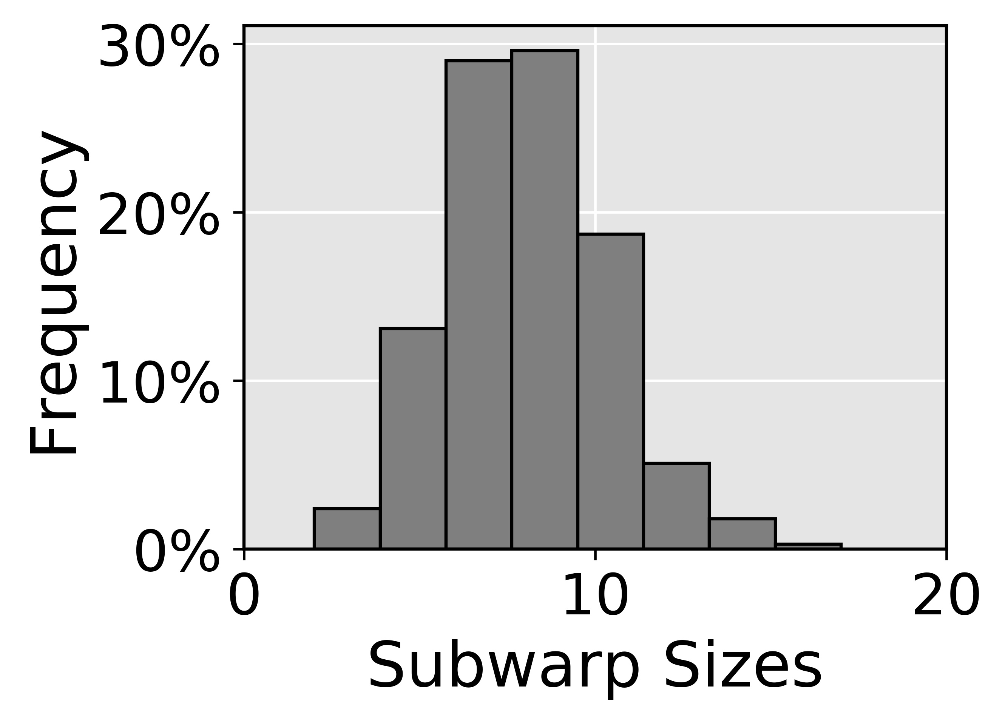
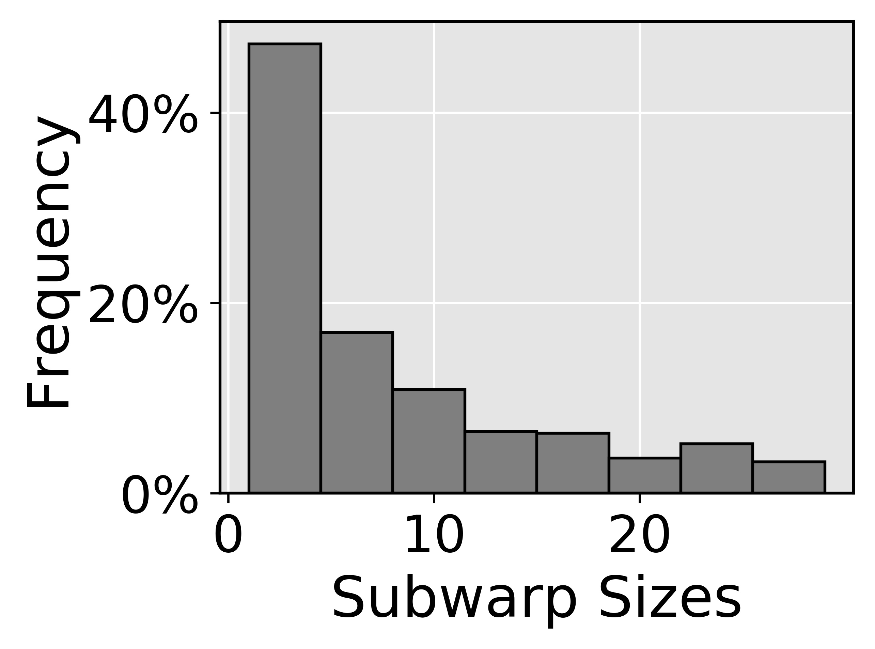
RCoal: Random Sized Subwarp (RSS)
Targets the deterministic nature of the coalescing mechanism
Fixed number of subwarps
Fixed sizes of subwarp
Deterministic mapping of the thread elements to subwarps
We select RSS with Skewed Distribution
Size distribution
RCoal to mitigate the correlation timing
attacks
RCoal to mitigate the correlation timing
attacks
✗
✓
Normal Distribution
Skewed Distribution
Mean of the distribution is same as FSS
Security and performance similar to FSS
Mean of the distribution is different than FSS
Large subwarp offers better coalescing
Improved security compared to FSS
Improved performance compared to FSS

Slide 81
RCoal: Random-Threaded Subwarp (RTS)
FSS: number of subwarps = 2
FSS+RTS: number of subwarps = 2
tid = 0
tid = 1
tid = 2
tid = 3
tid = 0
tid = 1
tid = 2
tid = 3
0x00
0x01
0x06
0x07
0x00
0x01
0x06
0x07
sid = 0
sid = 0
sid = 1
sid = 1
sid = 0
sid = 0
sid = 1
sid = 1
Coalescing Unit
Coalescing Unit
0x00
0x01
0x02
0x03
0x00
0x01
0x02
0x03
0x00
0x01
0x02
0x03
0x04
0x05
0x06
0x07
0x04
0x05
0x06
0x07
0x04
0x05
0x06
0x07

Slide 82
RCoal: Random-Threaded Subwarp (RTS)
RSS: number of subwarps = 2
RSS+RTS: number of subwarps = 2
sid = 0
sid = 1
sid = 0
sid = 1
tid = 0
tid = 1
tid = 2
tid = 3
tid = 2
tid = 0
tid = 1
tid = 3
0x00
0x01
0x06
0x08
0x06
0x00
0x01
0x08
Coalescing Unit
Coalescing Unit
0x00
0x01
0x02
0x03
0x00
0x01
0x02
0x03
0x00
0x01
0x02
0x03
0x04
0x05
0x06
0x07
0x04
0x05
0x06
0x07
0x08
0x09
0x0A
0x0B
0x08
0x09
0x0A
0x0B

Slide 83
Evaluation Set-up
AES-128
Plaintext with 32 lines
GPGPU-SIM
15 SMs, 32 threads/warp, one subwarp per coalescing unit (base case)
GDDR5 Memory with 6 MCs, 16 DRAM-banks, 4 bank-groups/MC
Enhanced Attack Algorithms
Corresponding Attacks

Slide 84
Security
(Lower the better)
Offers Security/Performance Trade-off
Execution Time
(Lower the better)
Notes:
Mention Rcoal in a BOX

Slide 85
Conclusions
We proposed RCoal, a set of three novel defense mechanisms
To mitigate the correlation timing attacks
Randomizes the memory access coalescing
Scales with the plaintext size (analysis in paper)
Theoretical analysis in the paper
RCoal offers a trade-off between security and performance and improves security at a modest performance loss.
Notes:
Try to reduce background and introduce rcoal_score

Slide 86
Acknowledgements
Mohamed Ibrahim (Ph.D. Student)
Gurunath Kadam
(Ph.D. student)
Hongyuan Liu
(Ph.D. student)
Haonan Wang
(Ph.D. student)
Fan Luo
(MS student, graduated)
Thank you!
Questions?
(Email: ajog@wm.edu)
Adwait Jog
(PI)
More details: http://insight-archlab.github.io/

Slide 87
Backup Slides

Slide 88
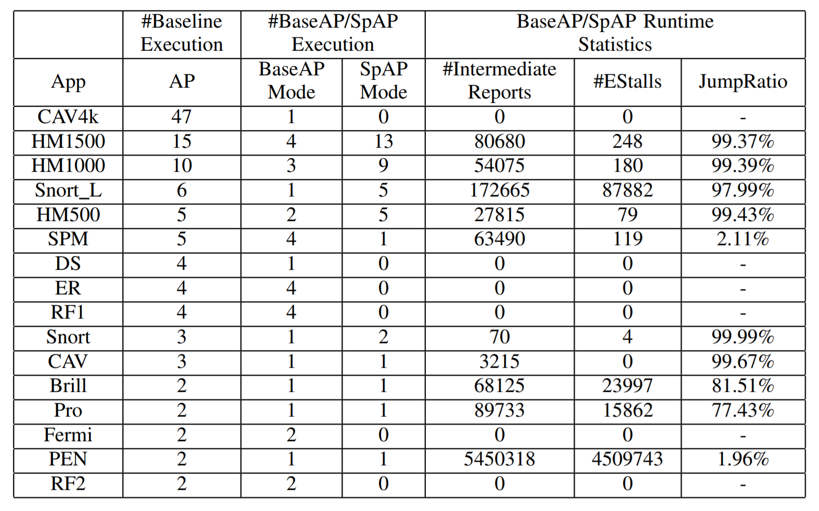
Jump Ratio

Slide 89
Sensitivity results: capacity = 49K
24x
2.1x
1.9x

Slide 90
Sensitivity results: capacity = 12K
29
54
7.5
8
2.2
1.9
If the AP size is smaller, more applications will have speedups.
Notes:
We also evaluate our results using a smaller AP, in which more applications have speedup.

Slide 91
AES implementation on GPU
Symmetric Encryption with 128-bit key and 10 rounds.
S-box implementation involves table lookups.
[Jiang/Fei/Kaeli, HPCA’16] demonstrated that the last round is vulnerable.

Slide 92
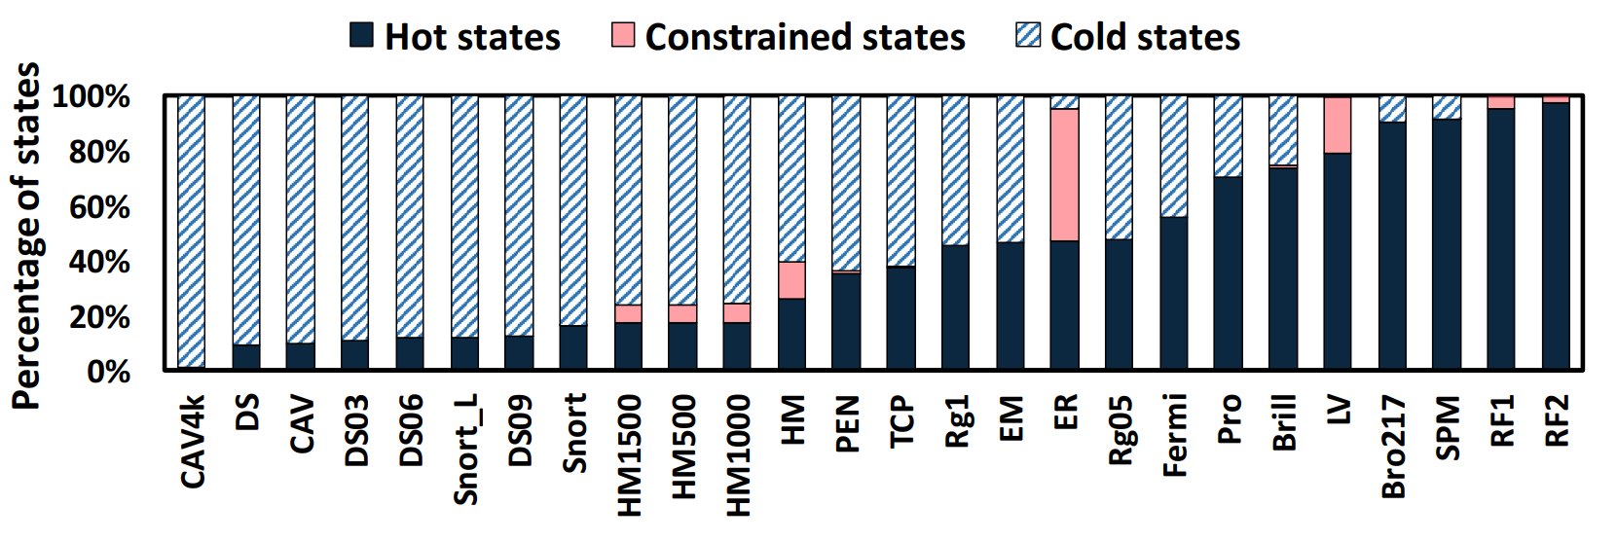
Topological-order-based Partition
Notes:
To

Slide 93
How to Predict Hot/Cold?
Use a small profiling input to predict the hot/cold states
Training
Testing
% from Input | 50% | 10% | 1% | 0.1%
% from Training | 100% | 20% | 2% | 0.2%
Accuracy | 97% | 93% | 90% | 87%
Notes:
First, we discuss how do we predict hot and cold states.
We use a simple profiling input to predict the hot and cold states.
To evaluate how a representative profiling input can predict the real situation in the execution, we evaluate the prediction in this methodology.
Each application has an 1MB input.
We split the input to two disjoint equal parts, which are training input and testing input.
We select different sizes of training input. We evaluate the accuracy of prediction by using different sizes of training input.
In our finial results, we use 1% and 0.1% of input.

